Slide 1
CACHE MEMORY
JASMIN T JOSE
ASST. PROFESSOR, SCSE
VIT UNIVERSITY, VELLORE

Slide 2
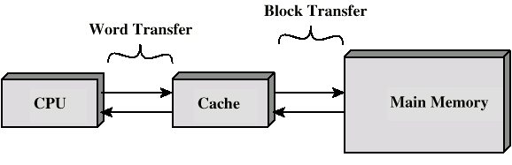
Cache Memory
A small amount of high speed memory between the main memory and the processor.
May be located on processor chip or separate module

Slide 3
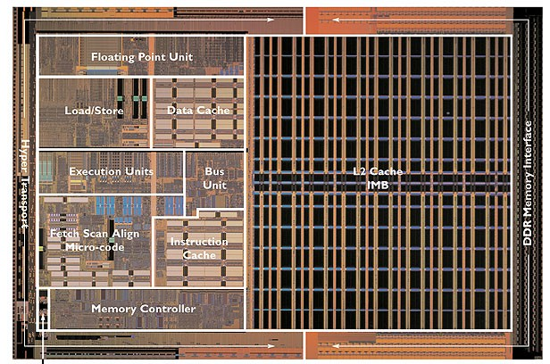
Cache Memory

Slide 4
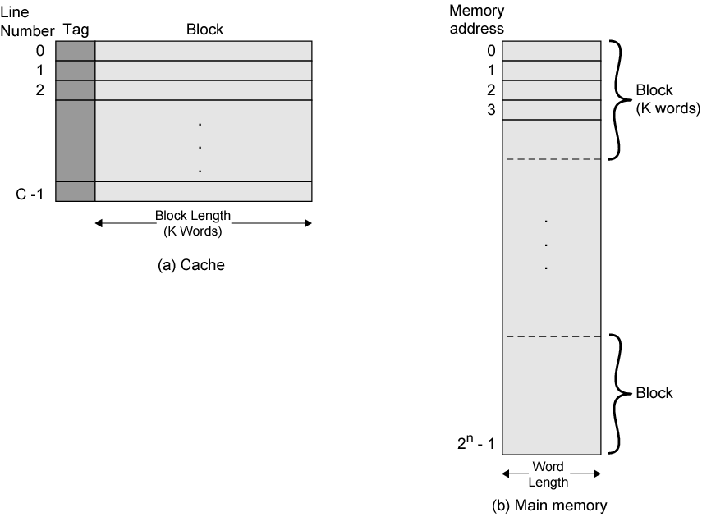
Cache memory Vs Main memory structure
Cache is partitioned into lines (also called blocks).
Each line has 4-64 bytes in it. During data transfer, a whole line is read or
written.
Cache includes tags to identify which block of main memory is in each cache line.

Slide 5
Cache organization
Split cache
Separate caches for instructions and data
I-cache (Instruction) – mostly accessed sequentially
D-cache (data) – mostly random access
Unified cache
Same cache for instruction and data
Higher hit rate for unified cache as it balances between instruction and data
Split caches eliminate contention for cache between the instruction processor and the execution unit – used for pipelining processes

Slide 6
Multilevel caches
The penalty for a cache miss is the extra time that it takes to obtain the requested item from central memory.
One way in which this penalty can be reduced is to provide another cache, the secondary cache, which is accessed in response to a miss in the primary cache.
The primary cache is referred to as the L1 (level 1) cache and the secondary cache is called the L2 (level 2) cache.
Most high-performance microprocessors include an L2 and L3 cache which is often located off-chip, whereas the L1 cache is located on the same chip as the CPU.
With a two-level cache, central memory has to be accessed only if a miss occurs in both caches.

Slide 7

Nehalem’s micro-architecture showing different cache memory levels

Slide 8
Small or slow
Unfortunately there is a tradeoff between speed, cost and capacity.
Fast memory is too expensive for most people to buy a lot of.
Here are rough estimates of some current storage parameters.
Storage | Speed | Cost | Capacity
Static RAM | Fastest | Expensive | Smallest
Dynamic RAM | Slow | Cheap | Large
Hard disks | Slowest | Cheapest | Largest
Storage | Delay | Cost/MB | Capacity
Static RAM | 1-10 cycles | ~$5 | 128KB-2MB
Dynamic RAM | 100-200 cycles | ~$0.10 | 128MB-4GB
Hard disks | 10,000,000 cycles | ~$0.0005 | 20GB-400GB
Notes:
The Athlon XP 1500+ with 384KB of total cache runs at 1.33GHz and retails for $52; a 1.3GHz Duron with 192KB cache retails for $44 as of 3/12/03.
A 2.2GHz Pentium 4 with a 512KB L2 cache sells for $163, while the 2.2GHz Celeron with 128KB of L2 costs $103 as of 2/23/03.
As of 4/15/03, a 128MB PC2700 DIMM at crucial.com costs $27, and a 512MB PC2700 DIMM is $80.
$63 for an OEM 20GB 7200 RPM Maxtor drive at newegg.com, and $118 for an OEM 120GB 7200 RPM Maxtor.

Slide 9
The principle of locality
It’s usually difficult or impossible to figure out what data will be “most frequently accessed” before a program actually runs, which makes it hard to know what to store into the small, precious cache memory.
But in practice, most programs exhibit locality, which the cache can take advantage of.
The principle of temporal locality says that if a program accesses one memory address, there is a good chance that it will access the same address again.
The principle of spatial locality says that if a program accesses one memory address, there is a good chance that it will also access other nearby addresses.

Slide 10
Temporal locality in programs
The principle of temporal locality says that if a program accesses one memory address, there is a good chance that it will access the same address again.
Loops are excellent examples of temporal locality in programs.
The loop body will be executed many times.
The computer will need to access those same few locations of the instruction memory repeatedly.
For example:
Each instruction will be fetched over and over again, once on every loop iteration.
Loop: lw $t0, 0($s1)
add $t0, $t0, $s2
sw $t0, 0($s1)
addi $s1, $s1, -4
bne $s1, $0, Loop

Slide 11
Spatial locality in programs
The principle of spatial locality says that if a program accesses one memory address, there is a good chance that it will also access other nearby addresses.
Nearly every program exhibits spatial locality, because instructions are usually executed in sequence—if we execute an instruction at memory location i, then we will probably also execute the next instruction, at memory location i+1.
Code fragments such as loops exhibit both temporal and spatial locality.
sub $sp, $sp, 16
sw $ra, 0($sp)
sw $s0, 4($sp)
sw $a0, 8($sp)
sw $a1, 12($sp)

Slide 12
Parameters of cache memory
i) Cache hit
Data found in cache.
Results in data transfer at maximum speed.
ii) Cache miss
Data not found in cache. Processor loads data from memory and copies
into cache (miss penalty).
iii) Hit ratio
Ratio of number of hits to total number of references =>
number of hits/(number of hits + number of Miss)
iv) Miss penalty
Additional cycles required to serve the miss
Time required for the cache miss depends on both the latency and
bandwidth
v) Latency – time to retrieve the first word of the block
vi) Bandwidth – time to retrieve the rest of this block

Slide 13
Sources of Cache Misses (Three C’s)
Compulsory Misses: These are misses that are caused by the cache being empty initially or by the first reference to a location in memory . Sometimes referred to as Cold misses.
Capacity Misses : If the cache cannot contain all the blocks needed during the execution of a program, capacity misses will occur due to blocks being discarded and later retrieved.
Conflict Misses: If the cache mapping is such that multiple blocks are
mapped to the same cache entry. Common in set associative or direct
mapped block placement, where a block can be discarded and later
retrieved if too many blocks map to its set. Also called collision or
interference misses.
Notes:
13

Slide 14
Start
Cache Read Operation
Receive Address from CPU
Is
Block Containing Item
in the cache
No
Access Main Memory for
the block containing the item
Yes
Select the cache line to receive
the block from Main Memory
Deliver Block To CPU
Load main Memory
Block into cache
Deliver block
To CPU
Done
Notes:
14

Slide 15
Direct Mapping
Block Placement
Set Associative
Fully Associative
Tag
Block Identification
Index
Offset
Cache Memory Management Techniques
FCFS
Block Replacement
LRU
Random
Write Through
Write back
Update Policies
Write around
Write allocate
Notes:
15

Slide 16
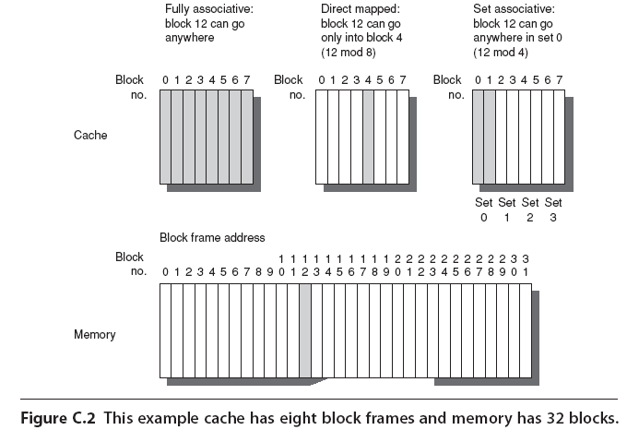
Example

Slide 17
Four important questions
1. When we copy a block of data from main memory to the cache, where exactly should we put it?
2. How can we tell if a word is already in the cache, or if it has to be fetched from main memory first?
3. Eventually, the small cache memory might fill up. To load a new block from main RAM, we’d have to replace one of the existing blocks in the cache... which one?
4. How can write operations be handled by the memory system?
Questions 1 and 2 are related—we have to know where the data is placed if we ever hope to find it again later!

Slide 18
Where should we put data in the cache?
A direct-mapped cache is the simplest approach: each main memory address maps to exactly one cache block.
For example, on the right
is a 16-byte main memory
and a 4-byte cache (four
1-byte blocks).
Memory locations 0, 4, 8
and 12 all map to cache
block 0.
Addresses 1, 5, 9 and 13
map to cache block 1, etc.
How can we compute this
mapping?
0
1
2
3
4
5
6
7
8
9
10
11
12
13
14
15
Index
0
1
2
3

Slide 19
It’s all divisions…
One way to figure out which cache block a particular memory address should go to is to use the mod (remainder) operator.
If the cache contains 2^{k}
blocks, then the data at
memory address i would
go to cache block index
i mod 2^{k}
For instance, with the
four-block cache here,
address 14 would map
to cache block 2.
14 mod 4 = 2
Memory
Address
0
1
2
3
4
5
6
7
8
9
10
11
12
13
14
15
Index
0
1
2
3

Slide 20
…or least-significant bits
An equivalent way to find the placement of a memory address in the cache is to look at the least significant k bits of the address.
With our four-byte cache
we would inspect the two
least significant bits of
our memory addresses.
Again, you can see that
address 14 (1110 in binary)
maps to cache block 2
(10 in binary).
Taking the least k bits of
a binary value is the same
as computing that value
mod 2^{k}.
Memory
Address
0000
0001
0010
0011
0100
0101
0110
0111
1000
1001
1010
1011
1100
1101
1110
1111
Index
00
01
10
11

Slide 21
How can we find data in the cache?
The second question was how to determine whether or not the data we’re interested in is already stored in the cache.
If we want to read memory
address i, we can use the
mod trick to determine
which cache block would
contain i.
But other addresses might
also map to the same cache
block. How can we
distinguish between them?
For instance, cache block
2 could contain data from
addresses 2, 6, 10 or 14.
Memory
Address
0
1
2
3
4
5
6
7
8
9
10
11
12
13
14
15
Index
0
1
2
3

Slide 22
Adding tags
We need to add tags to the cache, which supply the rest of the address bits to let us distinguish between different memory locations that map to the same cache block.
0000
0001
0010
0011
0100
0101
0110
0111
1000
1001
1010
1011
1100
1101
1110
1111
Index
Tag
Data
00
01
10
11
00
11
01
01

Slide 23
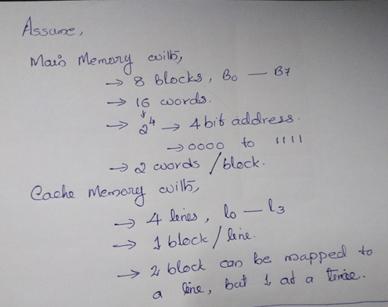

Slide 24
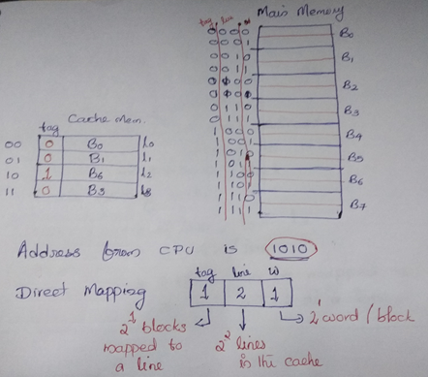

Slide 25
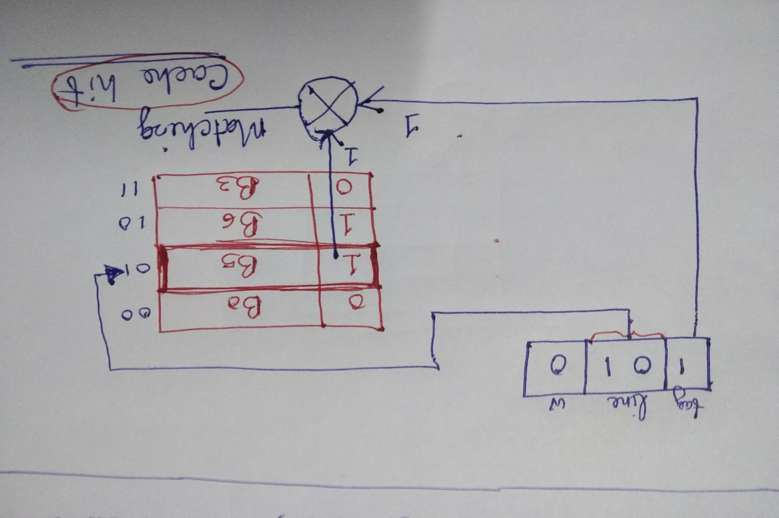
Cache hit

Slide 26
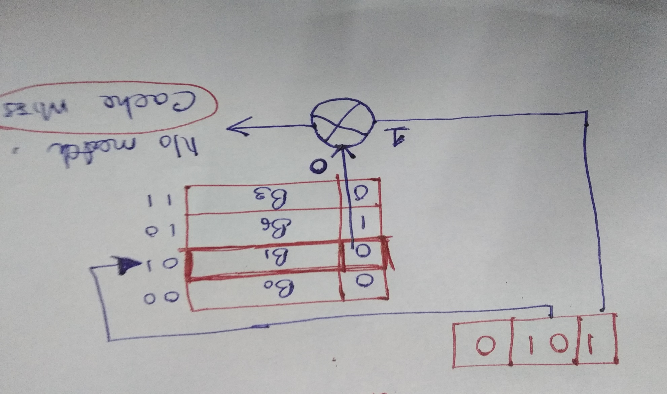
Cache miss

Slide 27
One more detail: the valid bit
When started, the cache is empty and does not contain valid data.
We should account for this by adding a valid bit for each cache block.
When the system is initialized, all the valid bits are set to 0.
When data is loaded into a particular cache block, the corresponding valid bit is set to 1.
So the cache contains more than just copies of the data in memory; it also has bits to help us find data within the cache and verify its validity.
Valid
Bit
Main memory
address in cache block
Index
Tag
Data
00
01
10
11
1
0
0
1
00
11
01
01
00 + 00 = 0000
Invalid
???
???

Slide 28
What happens on a cache hit
When the CPU tries to read from memory, the address will be sent to a cache controller.
The lowest k bits of the address will index a block in the cache.
If the block is valid and the tag matches the upper (m - k) bits of the m-bit address, then that data will be sent to the CPU.
Here is a diagram of a 32-bit memory address and a 2¹⁰-byte cache.
Address (32 bits)
Index
Valid
Tag
Data
0
1
2
3
...
...
1022
1023
22
10
Index
To CPU
Tag
=
Hit

Slide 29
Loading a block into the cache
After data is read from main memory, putting a copy of that data into the cache is straightforward.
The lowest k bits of the address specify a cache block.
The upper (m - k) address bits are stored in the block’s tag field.
The data from main memory is stored in the block’s data field.
The valid bit is set to 1.
Address (32 bits)
Index
Valid
Tag
Data
0
1
2
3
...
...
...
22
10
Index
Tag
Data
1

Slide 30
Mapping Function
Example 1
Assumption:
No. of lines(blocks) in a cache: 128
No. of blocks in main memory: 4096 blocks
No. of words in main memory: 64k words
No. of Words in a block: 16
No. address bits: 16 (64k=2¹⁰*2⁶)
Notes:
30

Slide 31
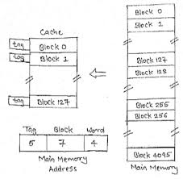
Direct Mapping

Slide 32
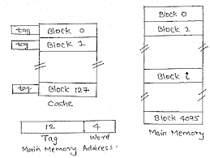
Fully Associative Mapping

Slide 33
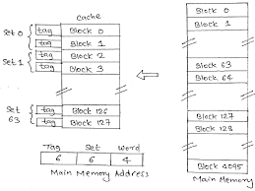
2-Way Set Associative Mapping

Slide 34
Mapping Function
Example 2
Assumption:
No. of lines(blocks) in a cache: 128
No. of blocks in main memory: 2046 blocks
No. of words in main memory: 64k words
No. of Words in a block: 32
No. address bits: 16 (64k=2¹⁰*2⁶)
Notes:
34

Slide 35
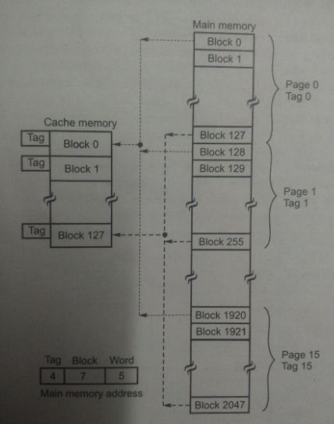
Direct Mapping

Slide 36
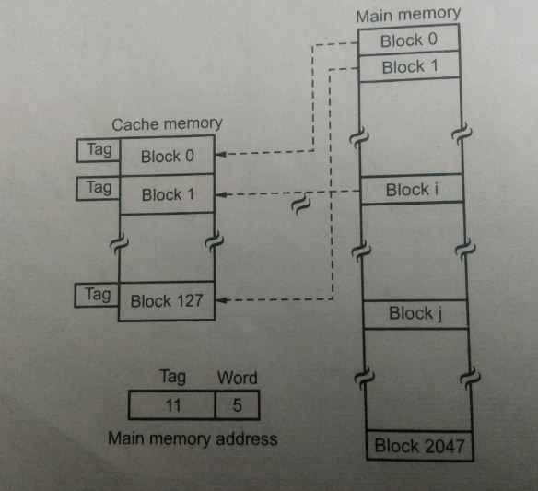
Fully Associative Mapping

Slide 37
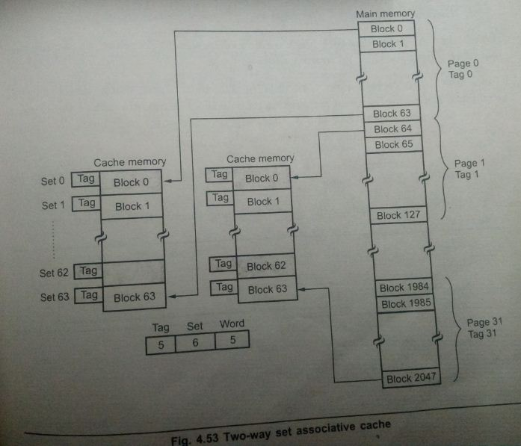
2-Way Set Associative Mapping

Slide 38
Problem 1
A set associative cache consists of 64 lines or slots, divided into four line sets. Main memory consists 4k blocks of 128 words each. Show the format of main memory addresses.

Slide 39
A set associative cache consists of 64 lines or slots, divided into four line sets. Main memory consists 4k blocks of 128 words each. Show the format of main memory addresses.
Tag = 2¹²/2⁴

Slide 40
Problem 2
A two-way set associative cache has lines of 16 bytes and a total size of 8k bytes. The 64-Mbyte main memory is byte addressable. Show the format of main memory addresses.

Slide 41
Problem 2
A two-way set associative cache has lines of 16 bytes and a total size of 8k bytes. The 64-Mbyte main memory is byte addressable. Show the format of main memory addresses.

Slide 42
Problem 3
Consider a cache consisting of 128 blocks of 16 words each, for a total of 2k words, and assume that the main memory is addressable by a 16 bit address and it consists of 4k blocks. Show the format of main memory address in all three types of mapping.
Assume 2way set associative for set associative mapping.

Slide 43
Direct:
Tag → 5bits → 2¹²/2⁷ =2⁵
Block → 7bits → 2⁷ = 128
Word → 4bits → 2⁴ =16 words in a block
Associative:
Set associative:
Tag → 6bits → 2¹²/2⁶ =2⁶
Set → 6bits → 2⁶ = 64 sets
Word → 4bits → 2⁴ =16 words in a block
5 | 7 | 4
12 | 4
6 | 6 | 4

Slide 44
problem4
A block set associative cache consists of a total of 64-lines divided into four-line sets. The main memory contains 4096 blocks, each consisting of 128 words.
What is the main memory address size?
Format of main memory address?
What is the size of cache memory?

Slide 45
What is the main memory address size?
Total word=4096*128=2¹⁹
Address size=19
Format of main memory address?
Tag→8bits, set→4bits, word→7bits
What is the size of cache memory? 64*128

Slide 46
Block Replacement
Least Recently Used: (LRU)
Replace that block in the set that has been in the cache longest with no reference to it.
First Come First Out: (FIFO)
Replace that block in the set that has been in the cache longest.
Least Frequently Used: (LFU)
Replace that block in the set that has experienced the fewest references
Notes:
46

Slide 47
First Come First Out: (FIFO)
Replace that block in the set that has been in the cache longest.
7 0 1 2 0 3 0 4 2 3 0 3 2 1 2 0 1 7 0 1
Least Frequently Used: (LFU)
Replace that block in the set that has experienced the fewest references

Slide 48
Update Policies - Write Through
Update main memory with every memory write operation
Cache memory is updated in parallel if it contains the word at specified address.
Advantage:
main memory always contains the same data as the cache
easy to implement Disadvantage: -
write is slower
every write needs a main memory access

Slide 49
Write Back
Only cache is updated during write operation and marked by flag. When the word is removed from the cache (at the time of replacement), it is copied into main memory
Advantage: - writes occur at the speed of the cache memory - multiple writes within a block require only one write to main memory Disadvantage: - harder to implement - main memory is not always consistent with cache

Slide 50
Update policies – Contd..
Write-Allocate
update the item in main memory and bring the block containing the updated item into the cache.
Write-Around or Write-no-allocate
correspond to items not currently in the cache (i.e. write misses) the item is updated in main memory only without affecting the cache.
Notes:
50

Slide 51
Write Through with Write Allocate: on hits it writes to cache and main memory on misses it updates the block in main memory and brings the block to the cache
Write Through with No Write Allocate: on hits it writes to cache and main memory; on misses it updates the block in main memory not bringing that block to the cache;

Slide 52
Write Back with Write Allocate: on hits it writes to cache setting dirty bit for the block, main memory is not updated; on misses it updates the block in main memory and brings the block to the cache;
Write Back with No Write Allocate: on hits it writes to cache setting dirty bit for the block, main memory is not updated; on misses it updates the block in main memory not bringing that block to the cache;

Slide 53
Update policies – Contd..
Write back:-Write only in cache, updating main memory only at the time of replacement.
Write through:-Both are updating for each write operation.
Write-Allocate:- first in main memory, then copy the block into cache.
Write-Around or Write-no-allocate:- when write miss occurred, updated in main memory without affecting the cache.
Notes:
53

Slide 54
Performance analysis
Look through: The cache is checked first for a hit, and if a miss occurs then the access to main memory is started.
Look aside: access to main memory in parallel with the cache lookup.
Notes:
54

Slide 55
Look through
TA = TC + (1-h)*TM
TA – Average read access time
TC is the average cache access time
TM is the average main memory access time
Look aside
TA = h*TC + (1-h)*TM
number of references found in the cache
hit ratio h =
total number of memory references
Miss Ratio m=(1-h)
Notes:
55

Slide 56
Example: assume that a computer system employs a cache with an access time of 20ns and a main memory with a cycle time of 200ns. Suppose that the hit ratio for reads is 90%,
what would be the average access time for reads if the cache is a look through-cache?
The average read access time (TA) = TC + (1-h)*TM
20ns + 0.10*200ns = 40ns
b) what would be the average access time for reads if the cache is a “look-Aside” cache?
The average read access time in this case (TA)
= h*TC + (1-h)*TM= 0.9*20ns + 0.10*200ns = 38ns
Notes:
56

Slide 57
Problem 1
Consider a memory system with T_{c} = 100ns and T_{m} = 1200ns. If the effective access time is 10% greater than the cache access time, what is the hit ratio H in look-through cache?
T_{A} = T_{C} + (1-h)*T_{M}
1.1 T_{c} = T_{c} + (1-h)*T_{M}
0.1T_{C} = (1-h)* T_{M}
0.1 * 100 = (1-h) *1200
1-h = 10/1200
h = 1190/1200

Slide 58
Problem 2
A computer system employs a write-back cache with a 70% hit ratio for writes. The cache operates in look-aside mode and has a 90% read hit ratio. Reads account for 80% of all memory references and writes account for 20%. If the main memory cycle time is 200ns and the cache access time is 20ns, what would be the average access time for all references (reads as well as writes)?
Notes:
58

Slide 59
Total Reference
100%
80% Reads
20 %Writes
90% hit
10% Miss
70 hit
30 Miss
The average access time for reads
= 0.9*20ns + 0.1*200ns = 38ns.
The average write time
= 0.7*20ns + 0.3*200ns = 74ns
Hence the overall average access time for combined reads and writes is
=0.8*38ns + 0.2*74ns = 45.2ns
Notes:
59

Slide 60
Total Reference
100%
80% Reads
20 %Writes
90% hit
10% Miss
70 hit
30 Miss
The average access time for reads
= 0.9*20ns + 0.1*200ns = 38ns.
The average access time for reads (Look through)
= 20ns + 0.1*200ns = 40ns.
The average write time
= 0.7*20ns + 0.3*200ns = 74ns
The average write time (Write through)
= 1*200ns= 200ns
Hence the overall average access time for combined reads and writes is
=0.8*38ns + 0.2*74ns = 45.2ns
Notes:
60

Slide 61
References
J. L. Hennessy & D.A. Patterson, Computer architecture: A quantitative approach, Fourth Edition, Morgan Kaufman, 2004.
Notes:
61

